Slide 1

Structure design
and
Platform development
Universal Template for Humanoid Algorithm Interface
ออกแบบโครงสร้างและพัฒนาระบบพื้นฐานสำหรับหุ่นยนต์ฮิวมานอยด์

Slide 2

UTHAI Update Progress
&
Software Structure
Hardware Structure

Slide 3
UTHAI Update Progress
&
Software Structure
Hardware Structure

Slide 4
Software Structure
UTHAI Humanoid
UTHAI Document
UTHAI Hardware
UTHAI Common
UTHAI Tools
UTHAI Motion and Perception PC
UTHAI Operating PC

Slide 5
Software Structure
UTHAI Humanoid
UTHAI Document
UTHAI Hardware
UTHAI Common
UTHAI Tools
UTHAI Motion and Perception PC
UTHAI Operating PC

Slide 6
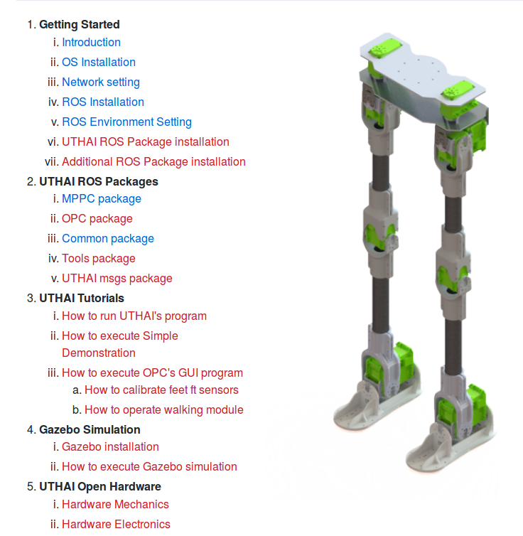
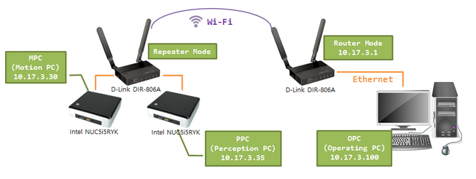
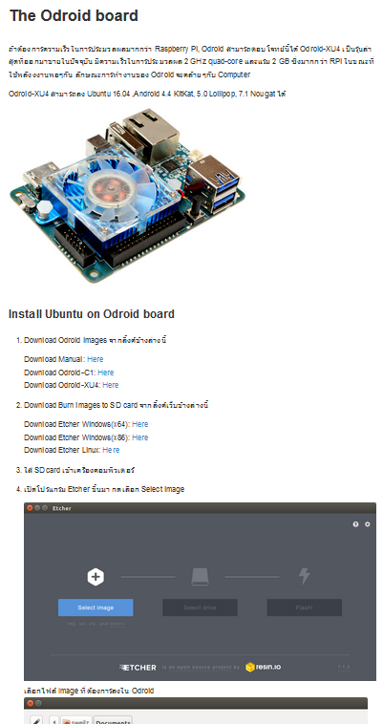
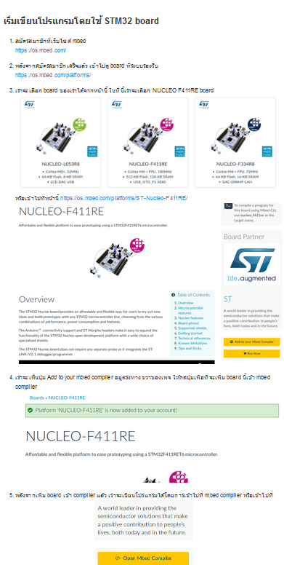
Software Structure
: UTHAI-Documents
UTHAI Document
Wiki

Slide 7
Software Structure
UTHAI Humanoid
UTHAI Document
UTHAI Hardware
UTHAI Common
UTHAI Tools
UTHAI Motion and Perception PC
UTHAI Operating PC

Slide 8
Software Structure
UTHAI Humanoid
UTHAI Document
UTHAI Hardware
UTHAI Common
UTHAI Tools
UTHAI Motion and Perception PC
UTHAI Operating PC

Slide 9
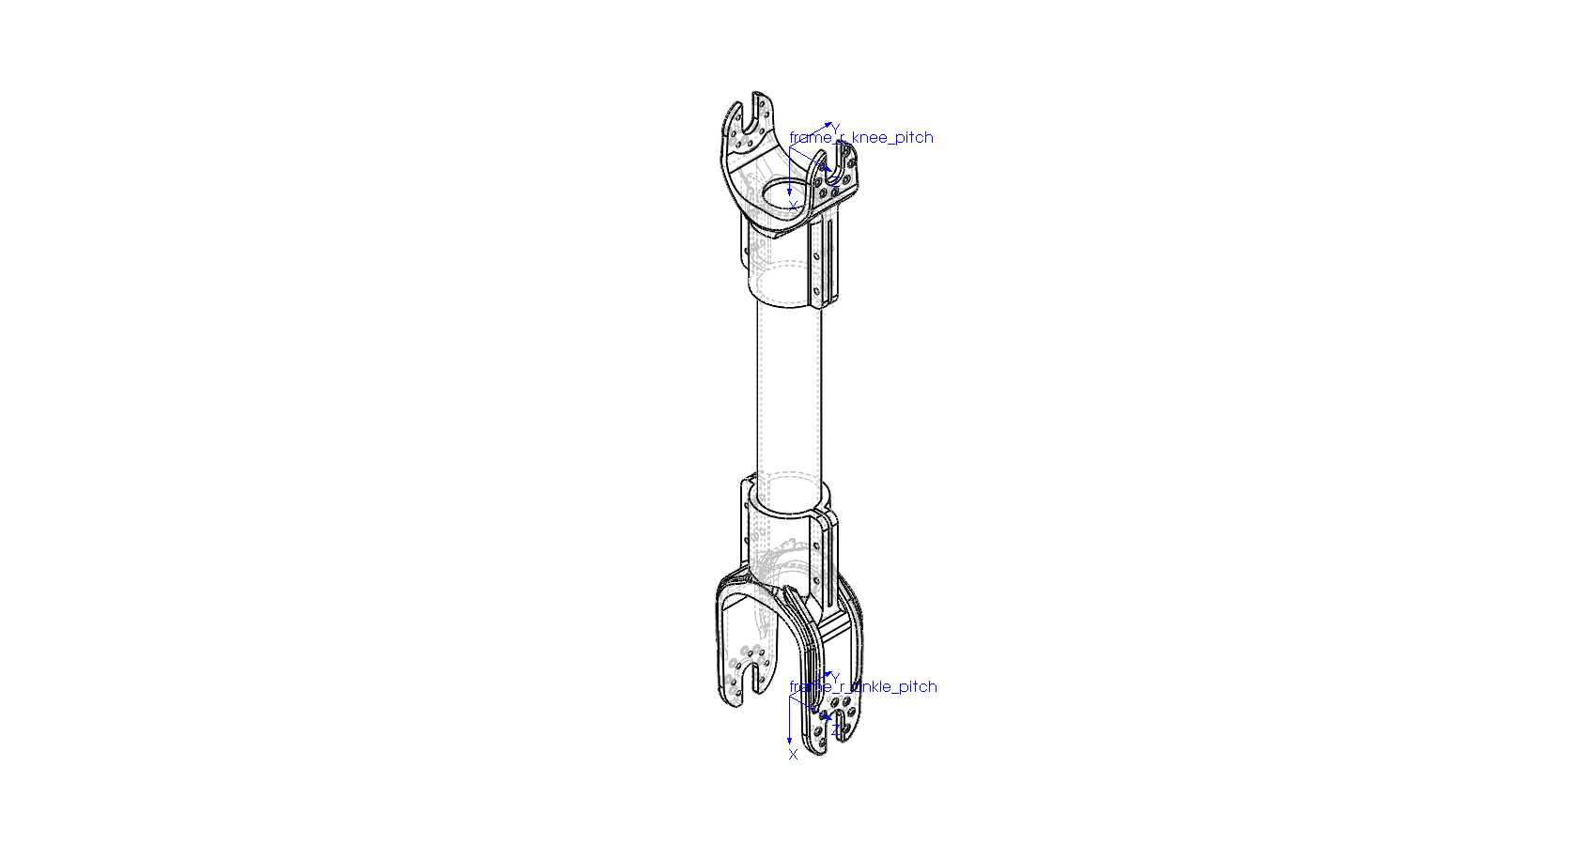
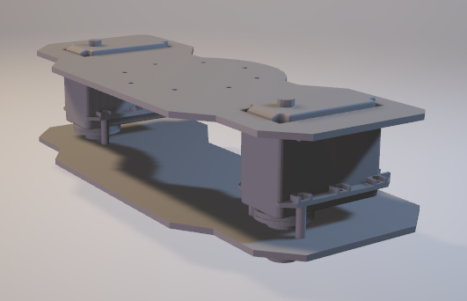
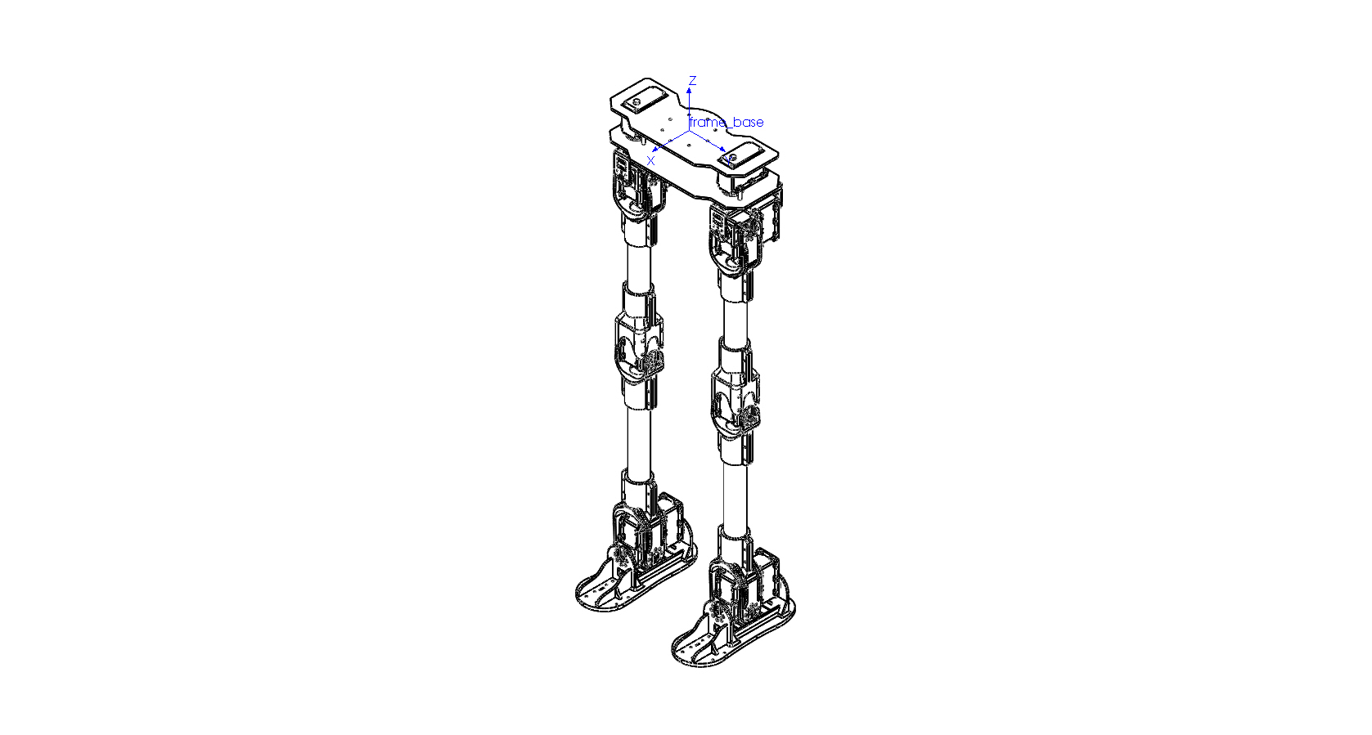
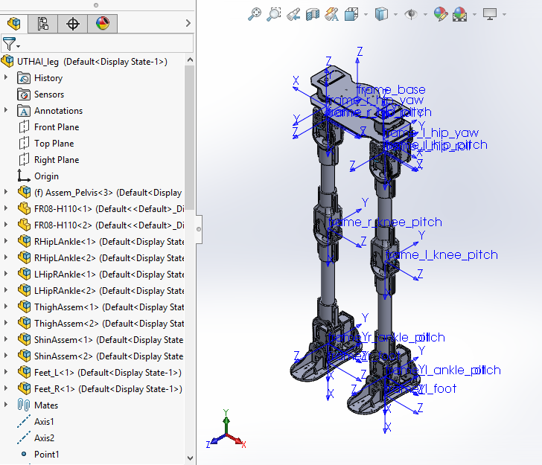
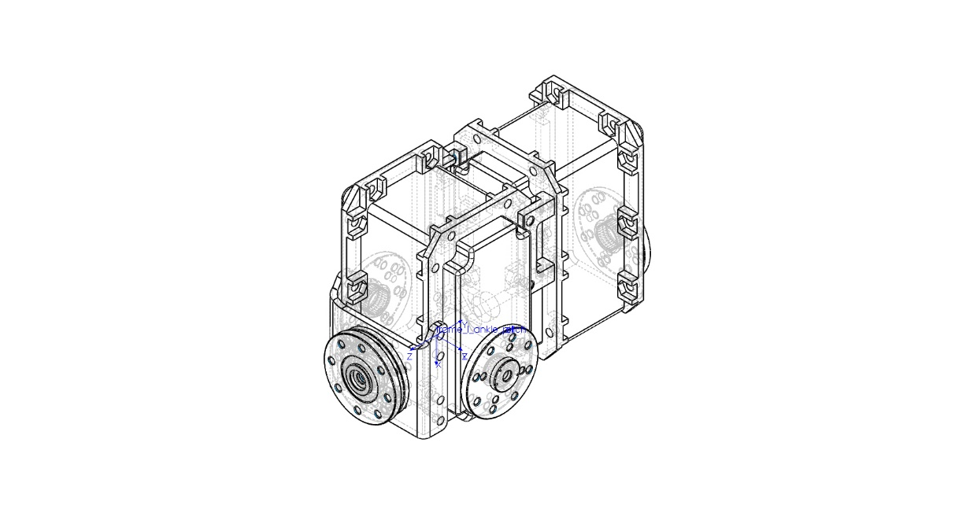
Software Structure
: UTHAI-Hardware
UTHAI Hardware

Slide 10
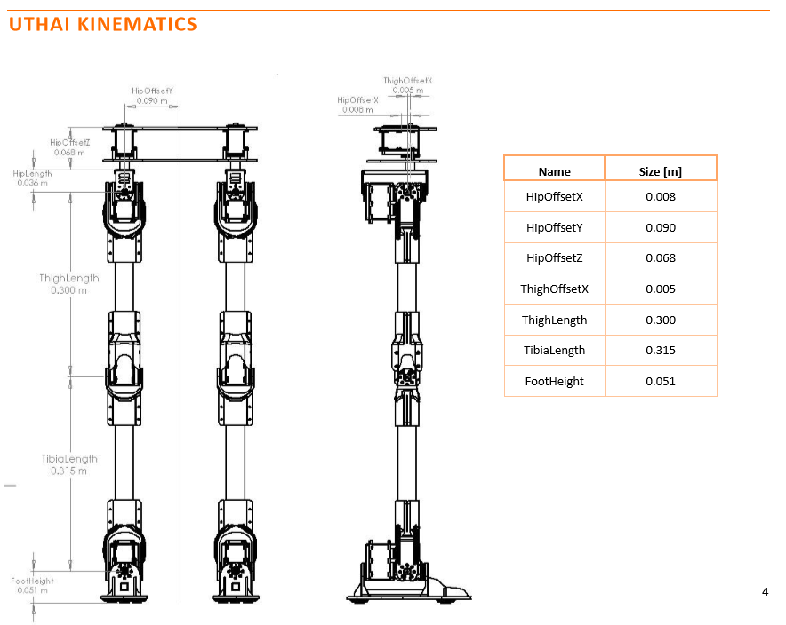
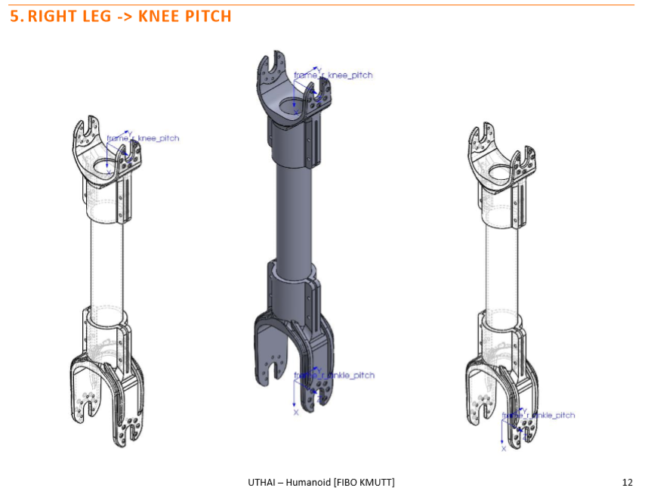
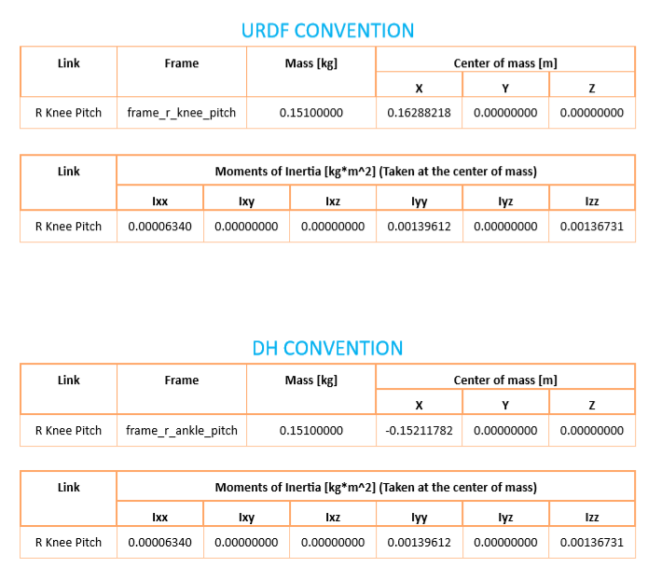
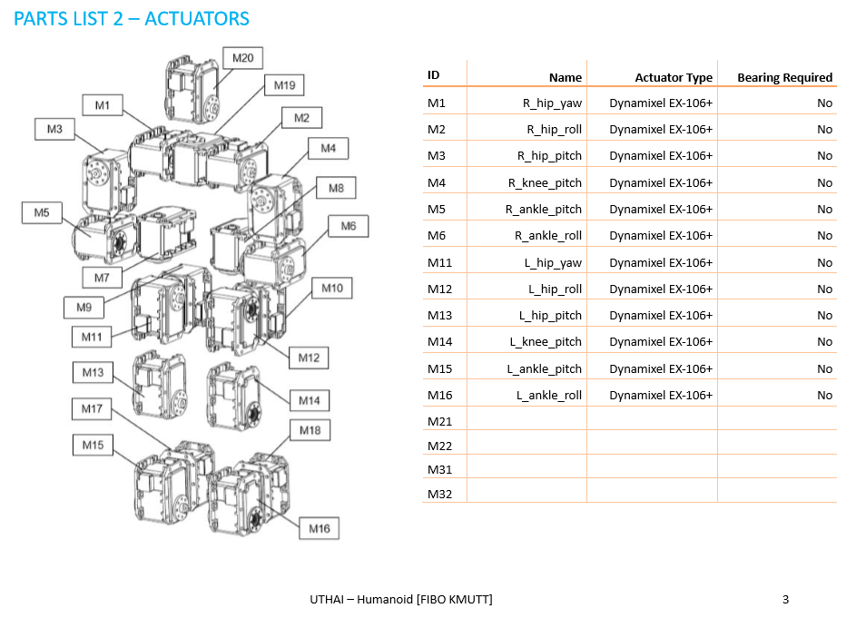
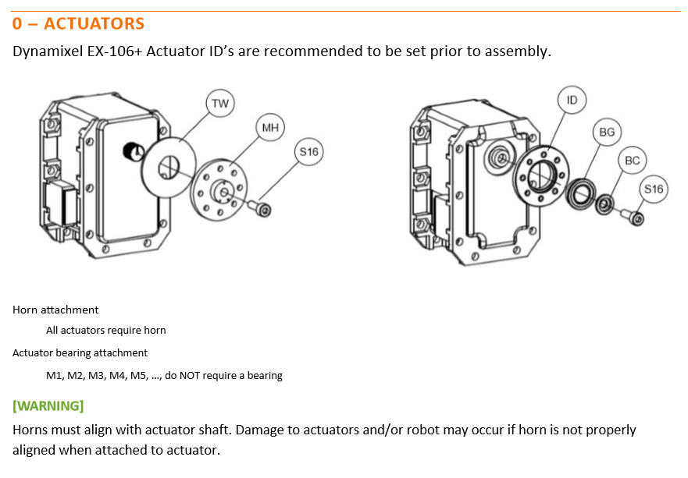
Software Structure
: UTHAI-Hardware
UTHAI Hardware
Kinematic properties
Dynamic properties
Assembly
Manual

Slide 11
Software Structure
UTHAI Humanoid
UTHAI Document
UTHAI Hardware
UTHAI Common
UTHAI Tools
UTHAI Motion and Perception PC
UTHAI Operating PC

Slide 12
Software Structure
UTHAI Humanoid
UTHAI Document
UTHAI Hardware
UTHAI Common
UTHAI Tools
UTHAI Motion and Perception PC
UTHAI Operating PC

Slide 13
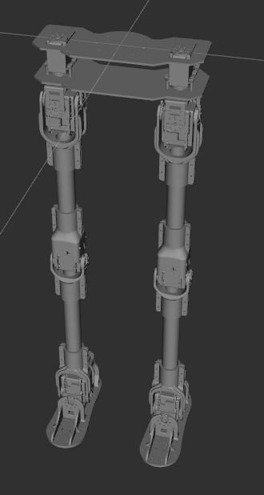
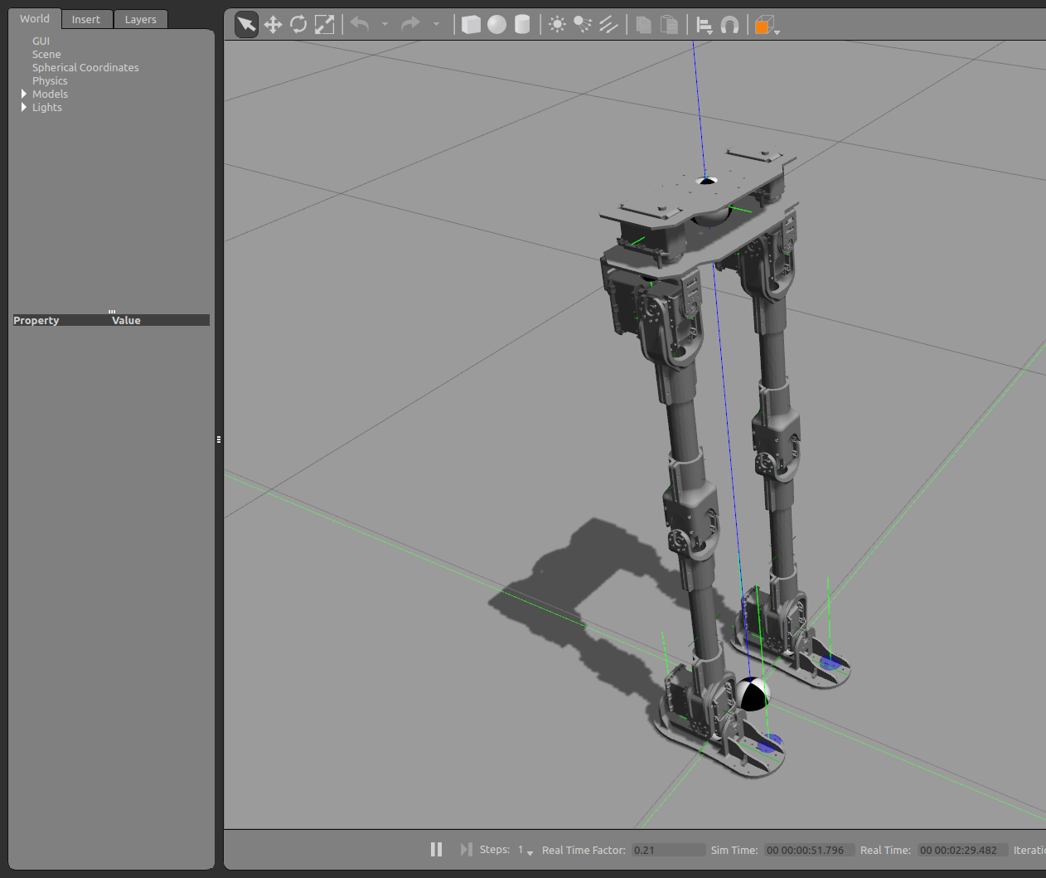
Software Structure
: UTHAI-Common
UTHAI Common
rviz
Visualization
Gazebo Simulation

Slide 14
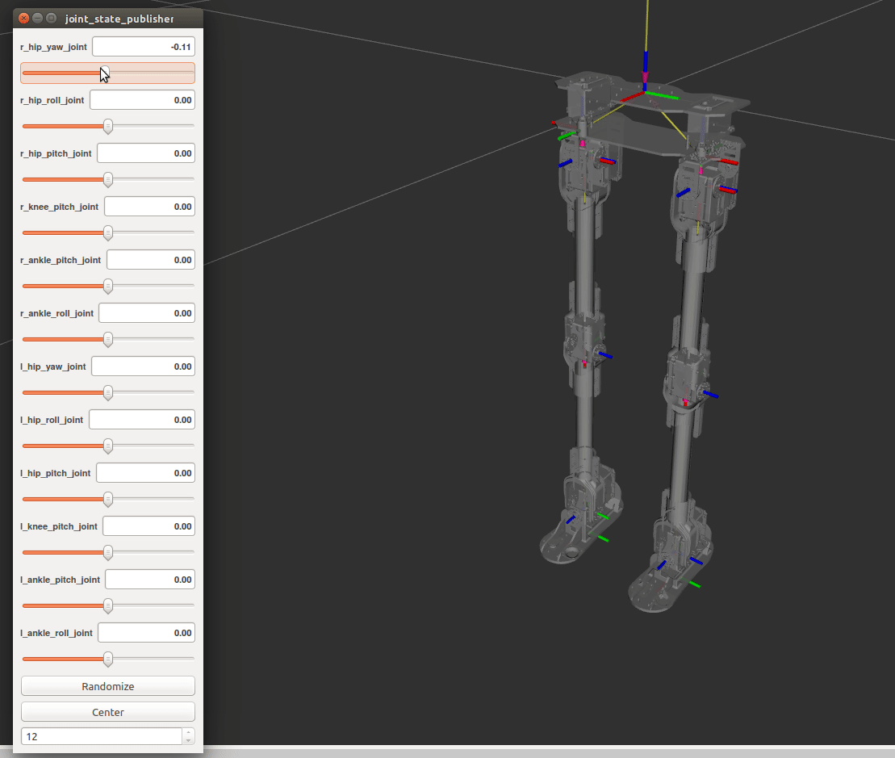
Software Structure
: UTHAI-Common
UTHAI Common
rviz
Visualization

Slide 15
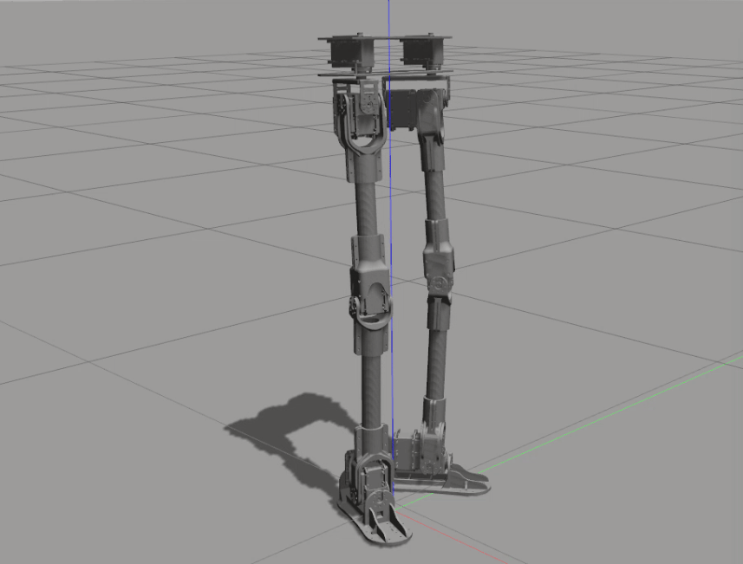
Software Structure
: UTHAI-Common
UTHAI Common
Gazebo
Simulation

Slide 16
Software Structure
UTHAI Humanoid
UTHAI Document
UTHAI Hardware
UTHAI Common
UTHAI Tools
UTHAI Motion and Perception PC
UTHAI Operating PC

Slide 17
Software Structure
UTHAI Humanoid
UTHAI Document
UTHAI Hardware
UTHAI Common
UTHAI Tools
UTHAI Motion and Perception PC
UTHAI Operating PC

Slide 18
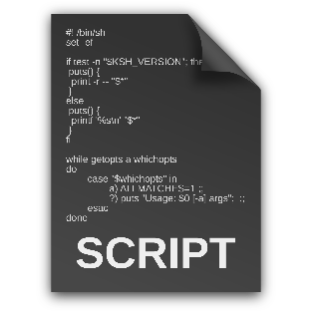

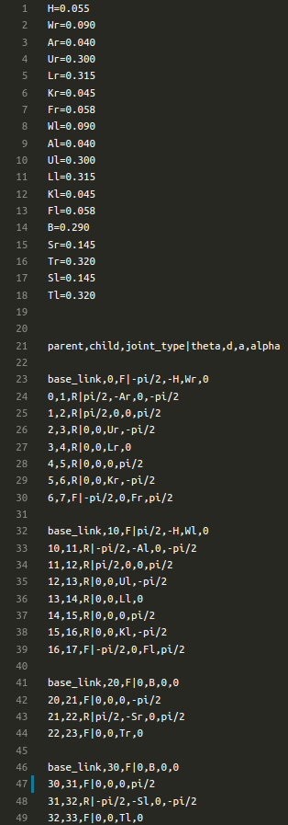
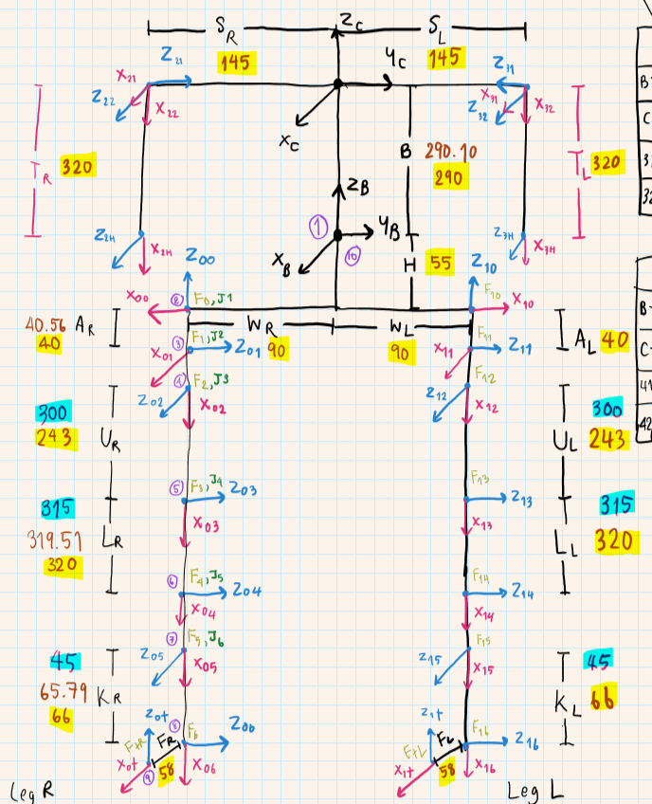
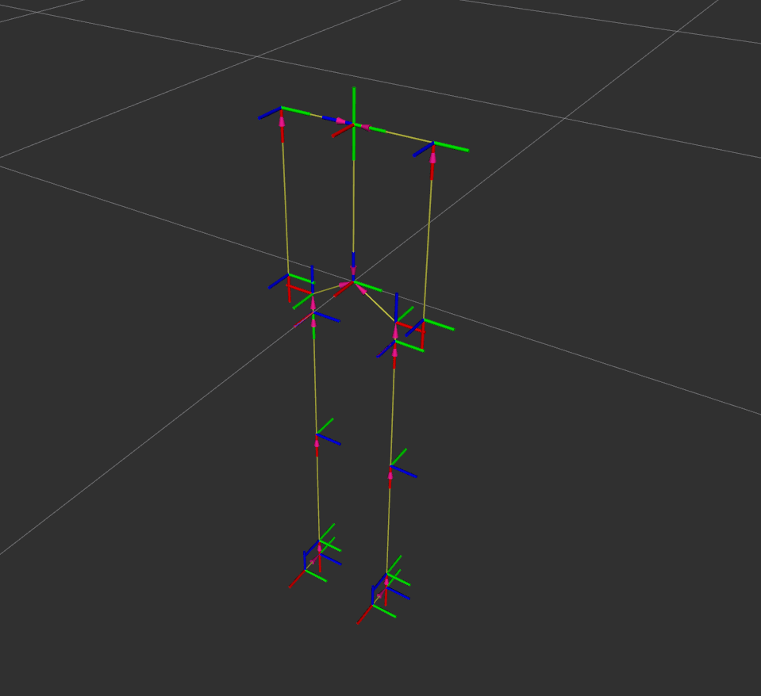
Software Structure
: UTHAI-Tools
UTHAI Tools
ROS Installer tool
DH Table to URDF converter tool

Slide 19
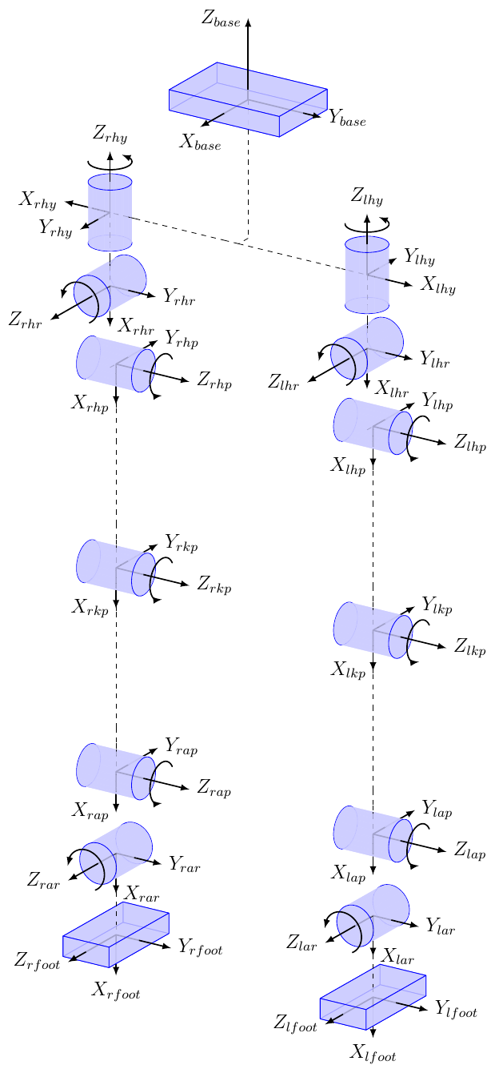
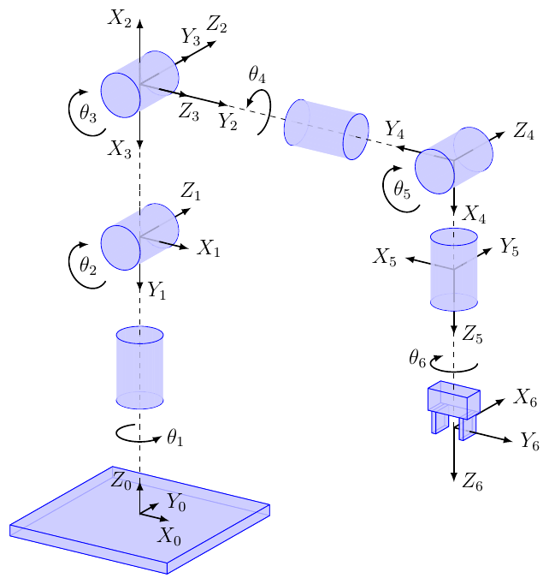
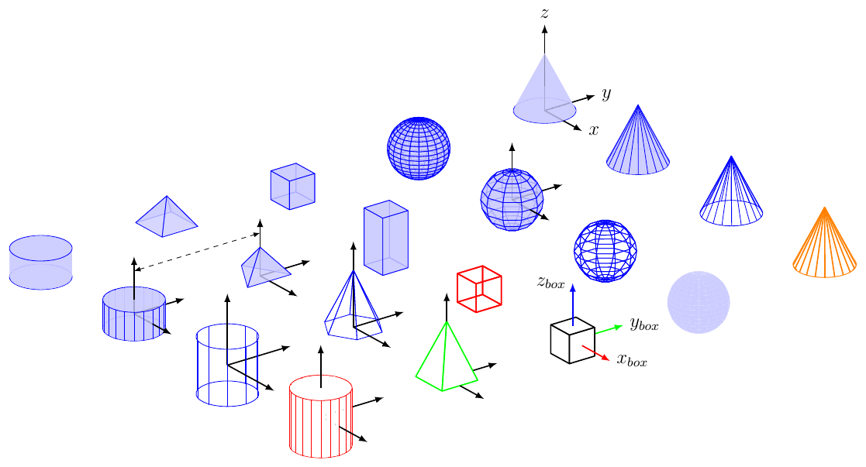
Software Structure
: UTHAI-Tools
UTHAI Tools
Robot sketch
drawing tool

Slide 20
Software Structure
UTHAI Humanoid
UTHAI Document
UTHAI Hardware
UTHAI Common
UTHAI Tools
UTHAI Motion and Perception PC
UTHAI Operating PC

Slide 21
Software Structure
UTHAI Humanoid
UTHAI Document
UTHAI Hardware
UTHAI Common
UTHAI Tools
UTHAI Motion and Perception PC
UTHAI Operating PC

Slide 22
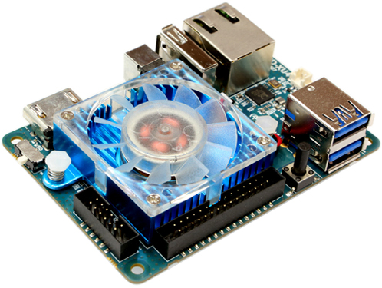
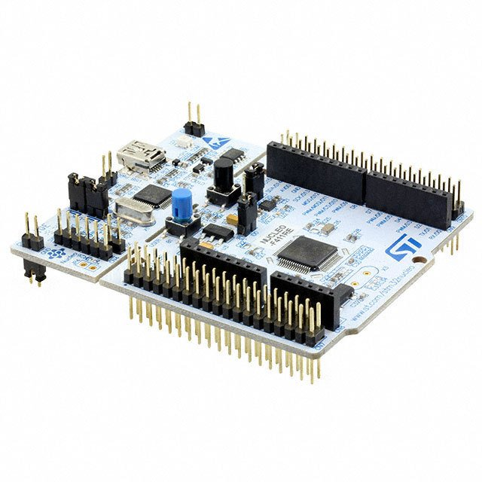
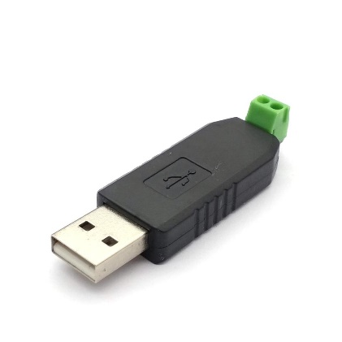
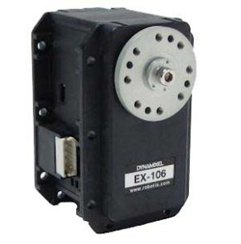
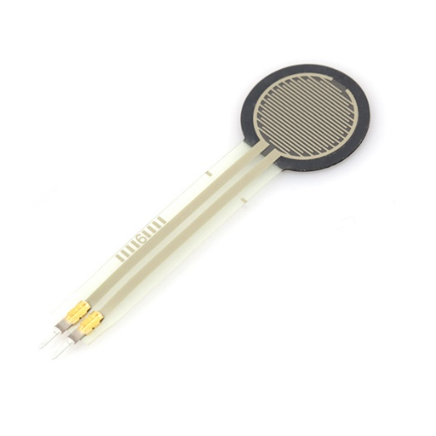
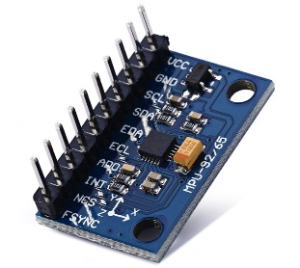
Software Structure
: UTHAI-MPPC
UTHAI MPPC

Slide 23
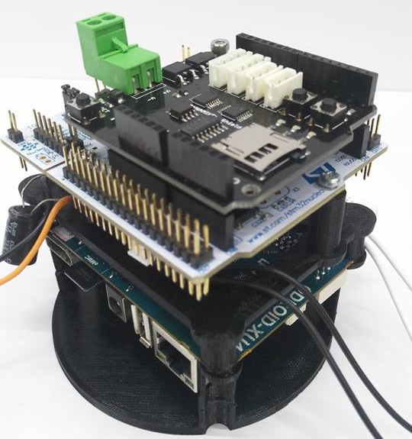
Software Structure
: UTHAI-MPPC
UTHAI MPPC
Motor
Position Controller
IMU Publisher
Ground Contact Publisher

Slide 24
Software Structure
UTHAI Humanoid
UTHAI Document
UTHAI Hardware
UTHAI Common
UTHAI Tools
UTHAI Motion and Perception PC
UTHAI Operating PC

Slide 25
Software Structure
UTHAI Humanoid
UTHAI Document
UTHAI Hardware
UTHAI Common
UTHAI Tools
UTHAI Motion and Perception PC
UTHAI Operating PC

Slide 26
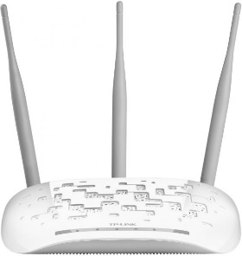
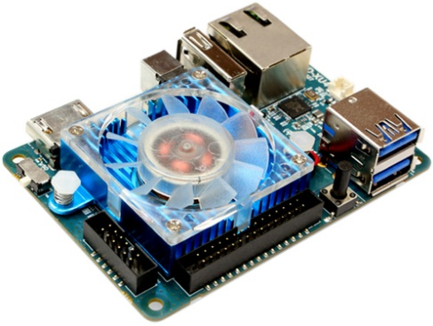
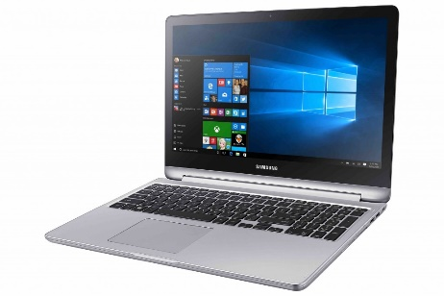
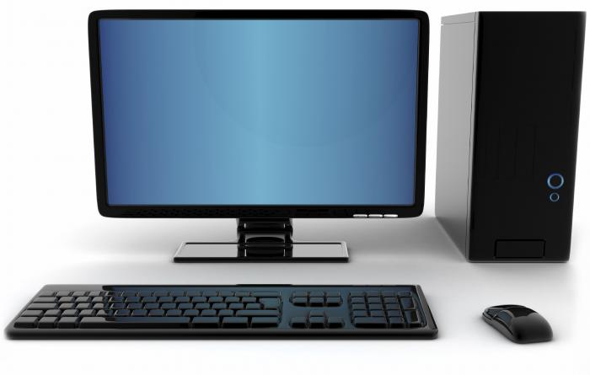
Software Structure
: UTHAI-OPC
UTHAI OPC
State Estimator
Path
Planning
Foot-Step
Generator
CoM
Controller
Visualization
Simulation

Slide 27
UTHAI Update Progress
&
Software Structure
Hardware Structure

Slide 28
UTHAI Update Progress
&
Hardware Structure
Software Structure

Slide 29
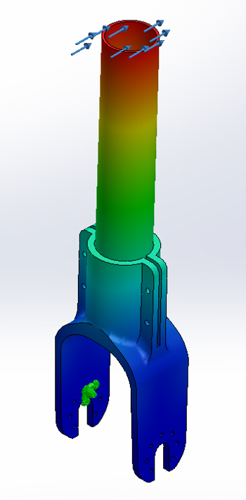
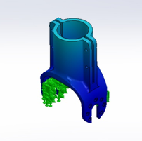
Finite element analysis
Hardware Structure

Slide 30
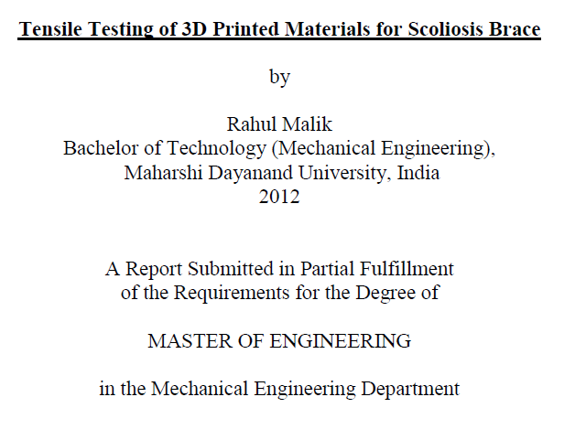
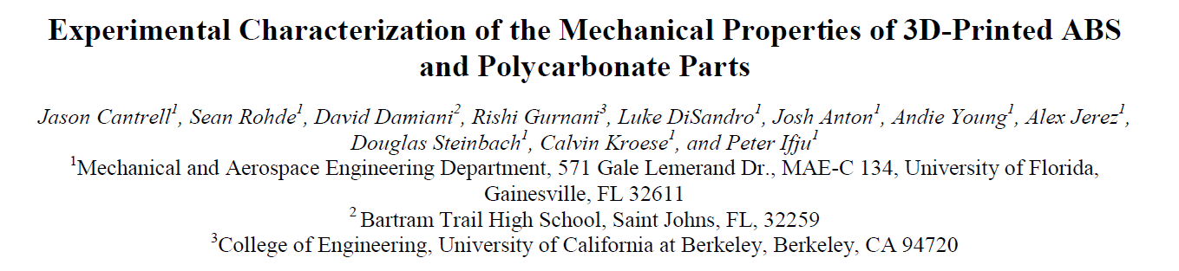
Collect Data
Hardware Structure

Slide 31
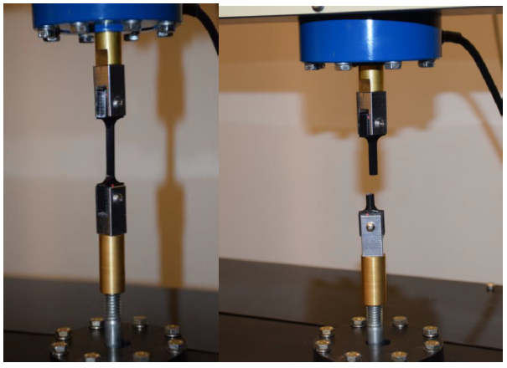
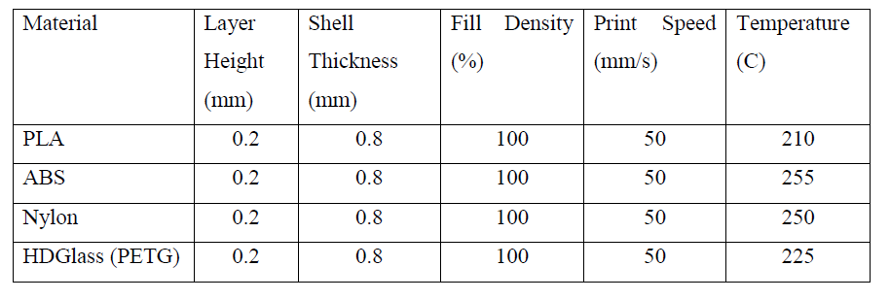
Experiment method
Hardware Structure

Slide 32
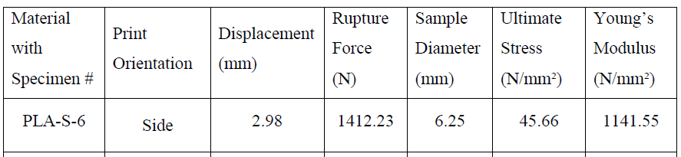
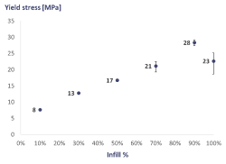
Experiment Result
Hardware Structure

Slide 33
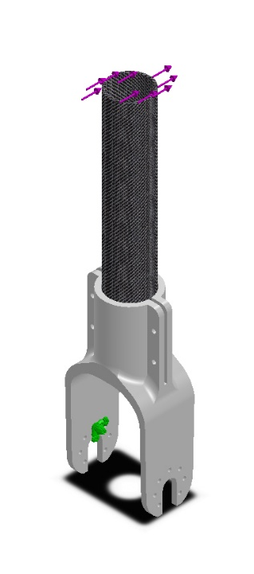
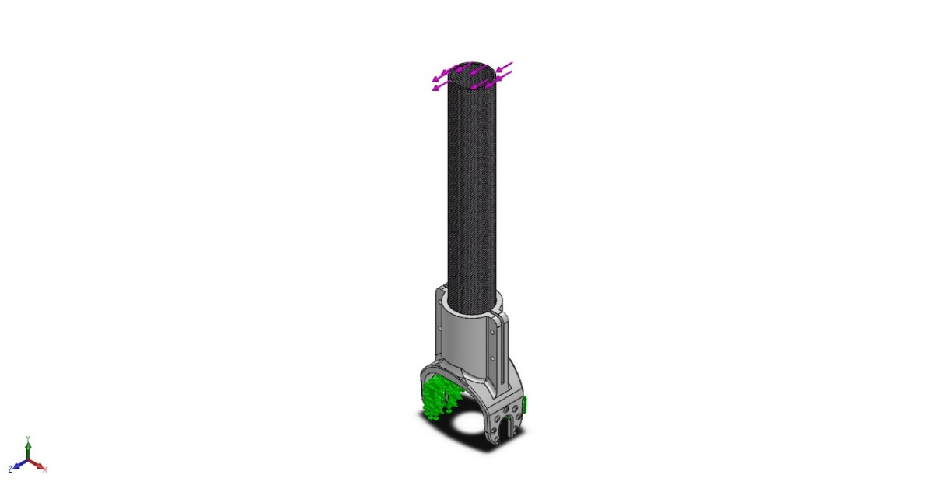
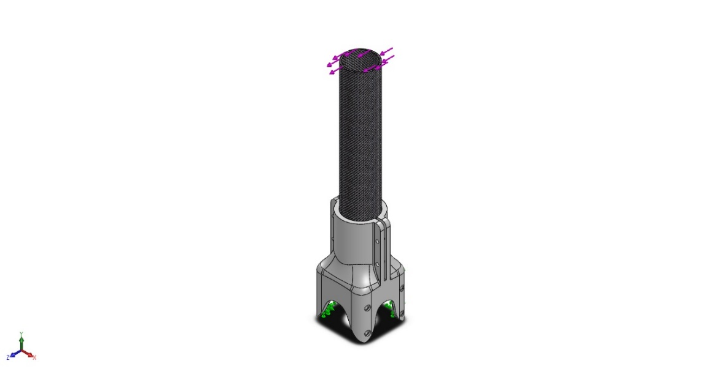
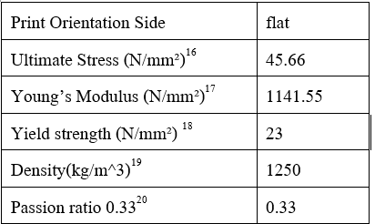
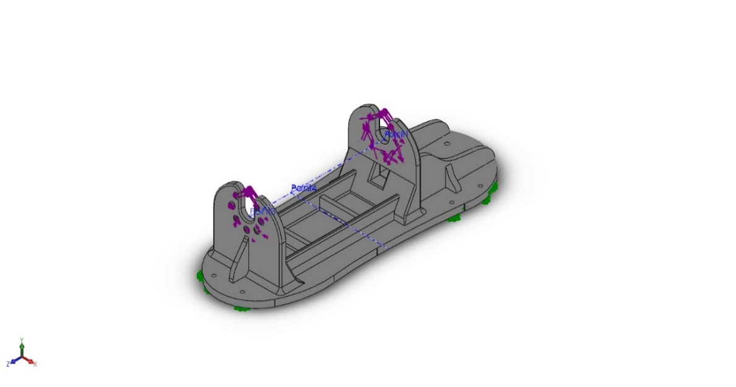
Set up our FEA
Hardware Structure

Slide 34
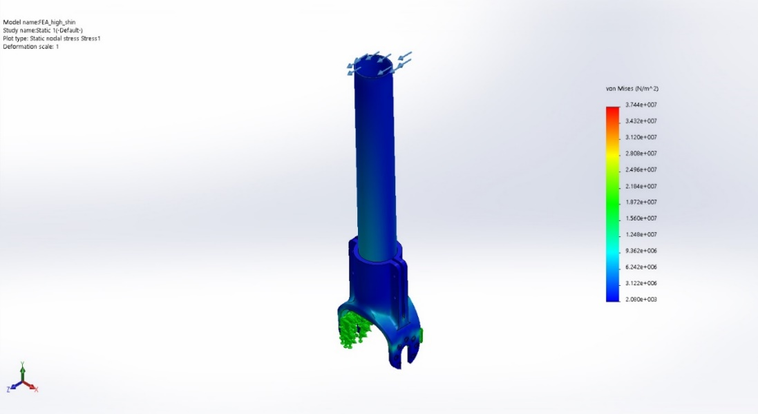




Our result
Hardware Structure

Slide 35





Build
Controller
Summarization
Calibrate
Test application
Walking robot
Background Research
Physiology
Robot structure
Design and Simulation
Software Diagram
Robot Skeleton
CAD 3D Model
Mechanical build
Workflow
Documents

Slide 36


Gantt chart
1
29 สิงหาคม 2560
2
13 ตุลาคม 2560
3
27 ตุลาคม 2560
4
22 ธันวาคม 2560
5
26 มกราคม 2561
6
30 มีนาคม 2560

